Slide 1
Progress Report
Week 7 presentation

Slide 2
Team member
Front-end:
Tiansheng Liu 470342488
Fengjun Li 470342112
Yinan Chen 470041259
Kewen Su 470503539
Back-end:
Trung Kien Hoang 470020243
Xiaohan Li 470011746
Haozhe Zhang 460335162
Group 3 – Day Dream
Presenter – Tiansheng Liu 470342488
Project:
Web Platform for Client-Supplier Business Management

Slide 3
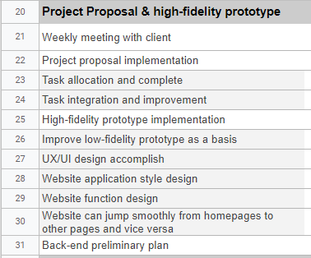
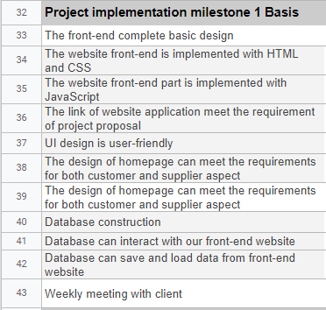
Current Progress vs Original Progress
Development Strategy: Agile
Teamwork Method: Scrum
Phase 3
- Phase 4
Before the holiday, we confirmed our high-quality prototype with our client and got some suggestions to improve. For the project proposal, our client said he was too busy and he needs a new deadline to give us feedback and his signature.

Slide 4
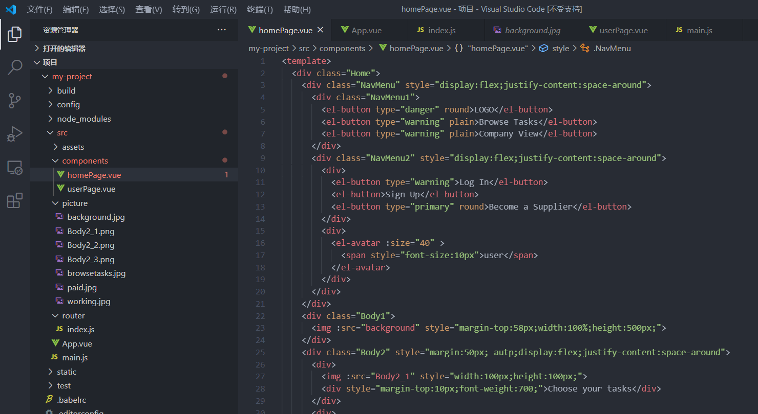
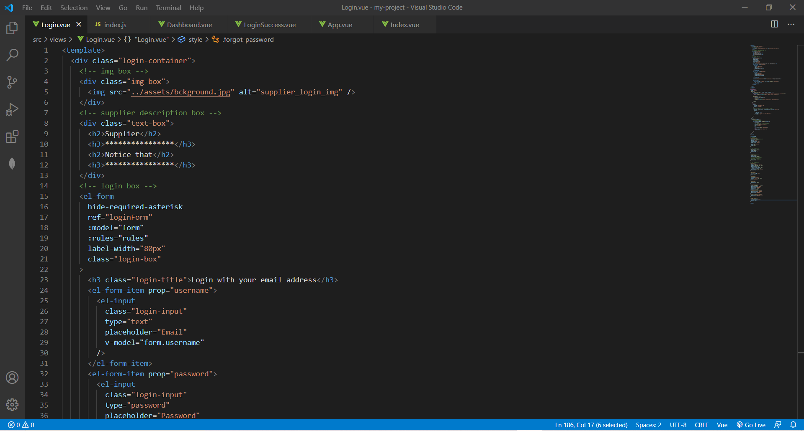
Comment on current progress
Front-end Development:
Completed the basic design of three pages(Suppliers’ homepage, Login and Signup)
Suppliers’ dashboard page is developing
UI design is relatively simple, details of UI design will be added later(will be improved)
The most difficult "Browse Tasks" page has not yet been developed, which is a challenge for the front-end development team
Screenshots for project:

Slide 5
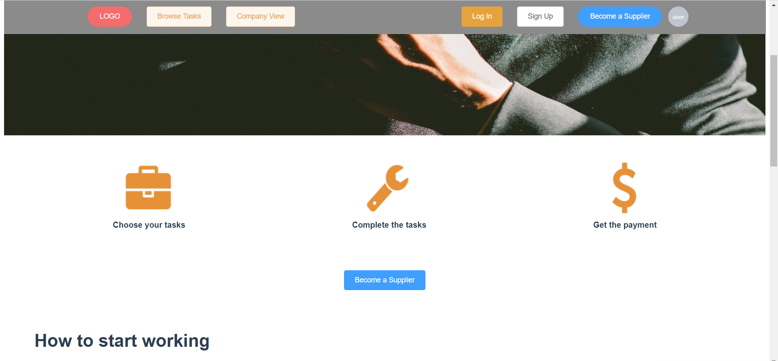
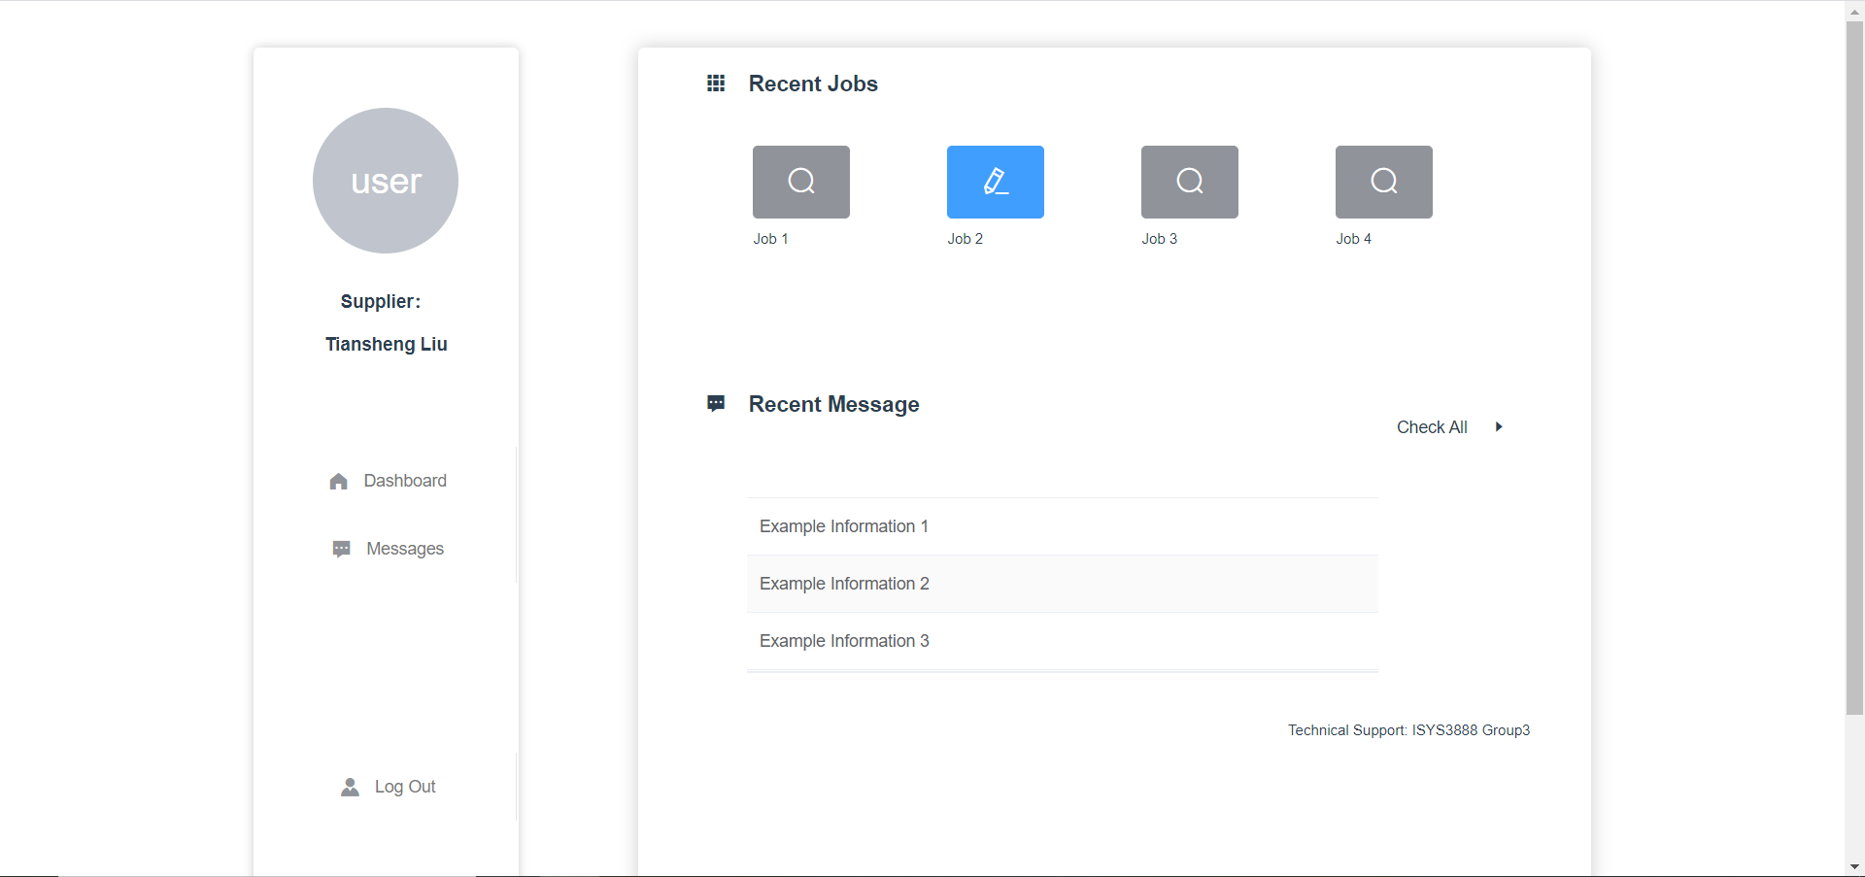
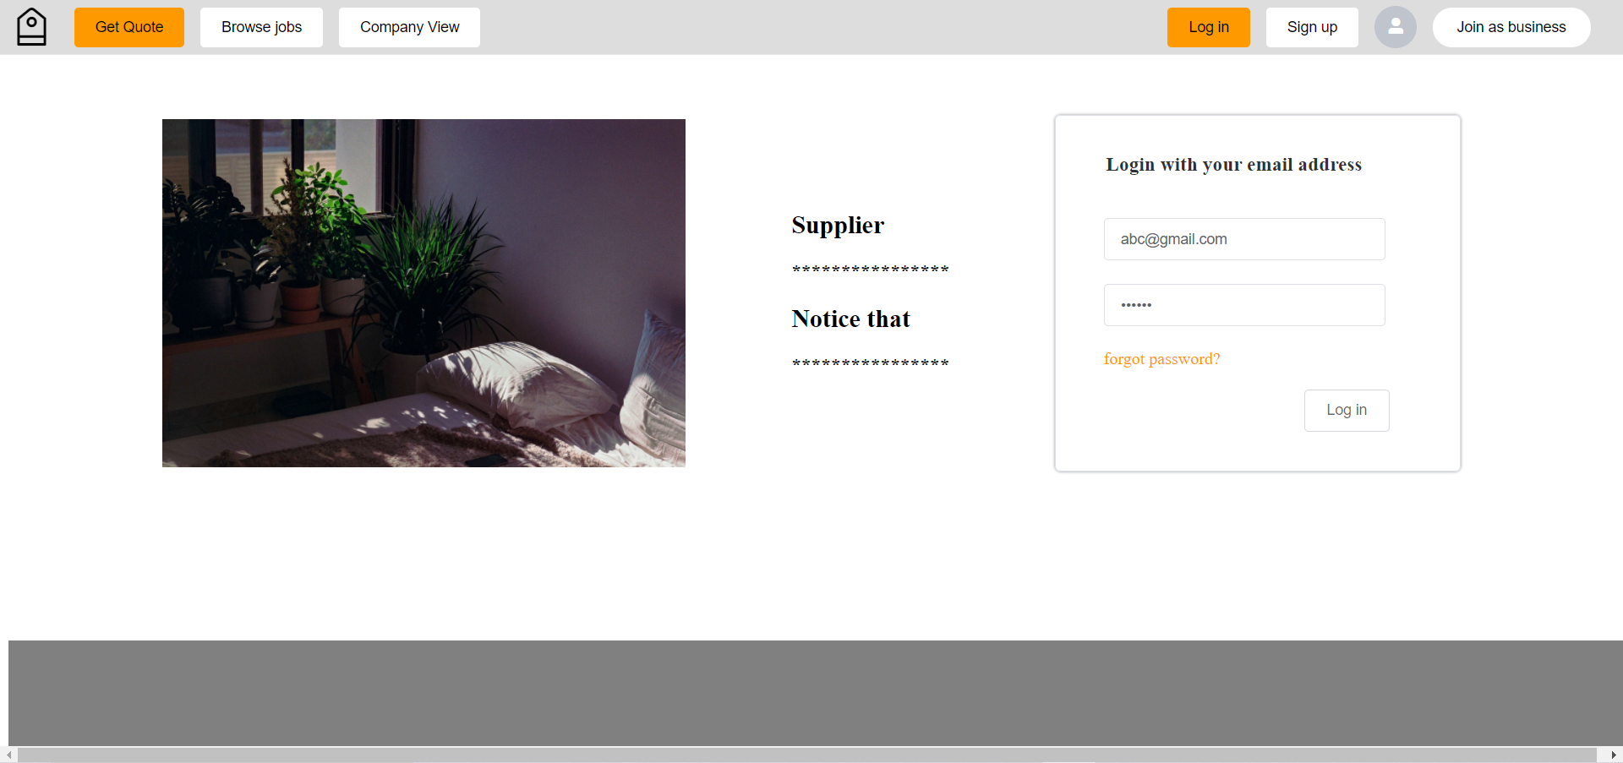
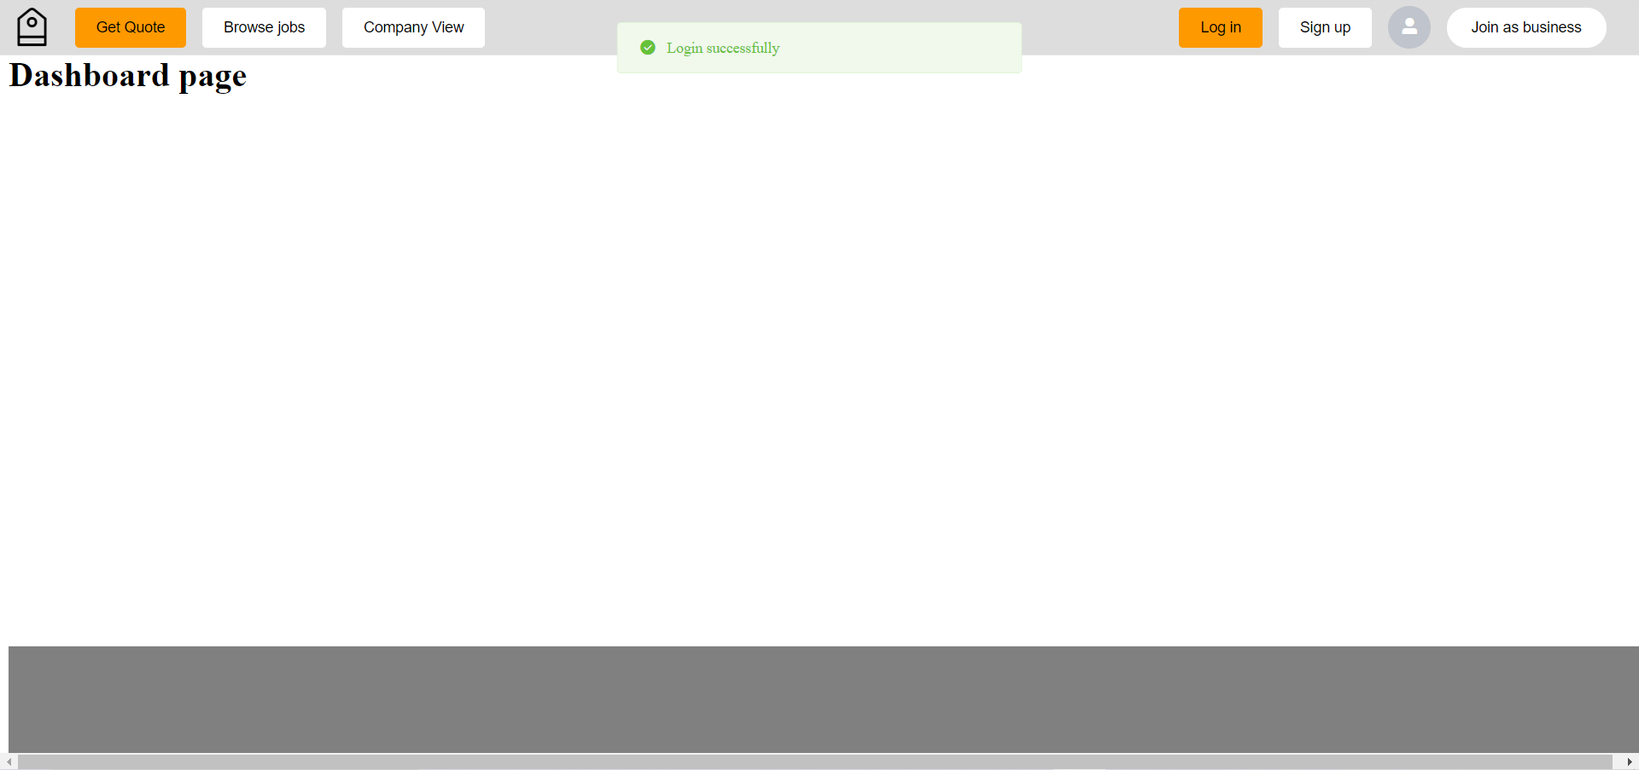
Comment on current progress
Developing
Screenshots for project:

Slide 6
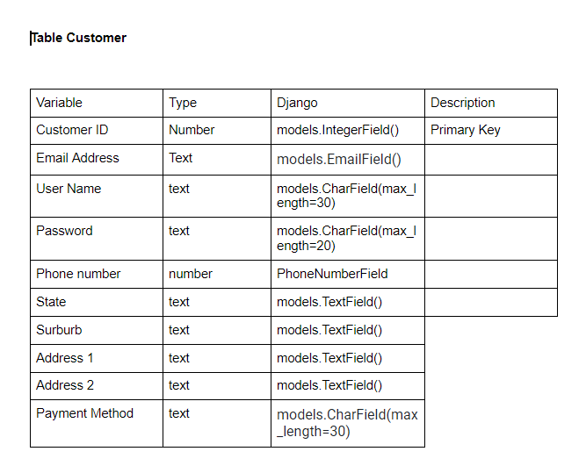
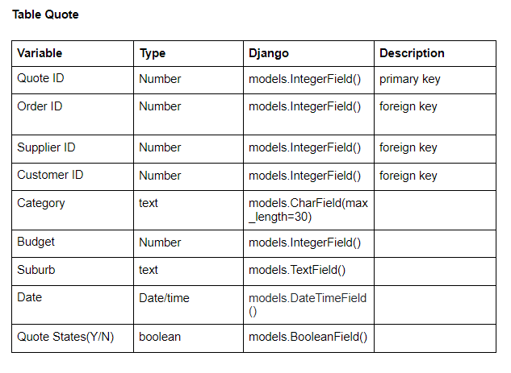
Comment on current progress
Back-end Development:
Group meeting to determine the variable names of the database
Determine the programming language and framework required for development
Prepare for the next step – Database Construction
Screenshots for project:

Slide 7
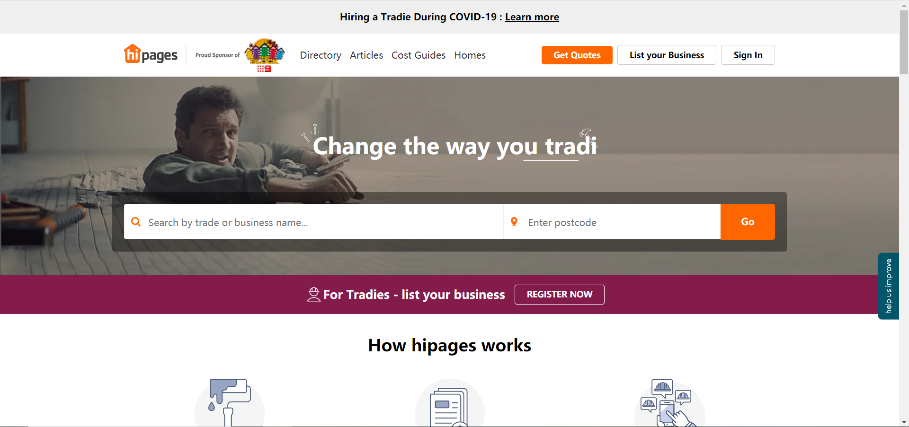
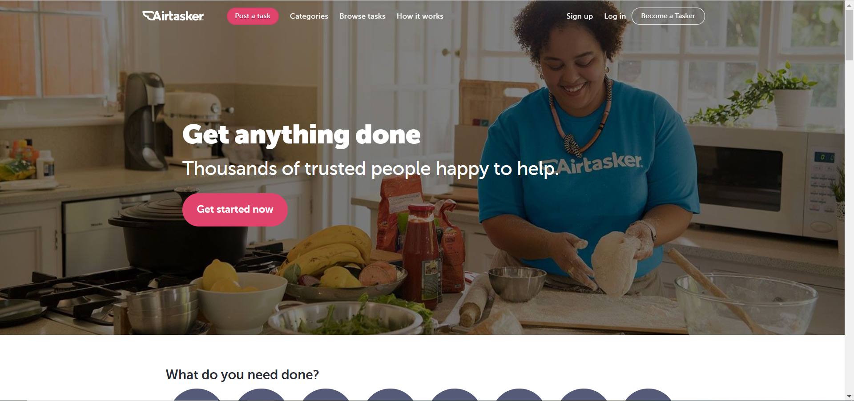
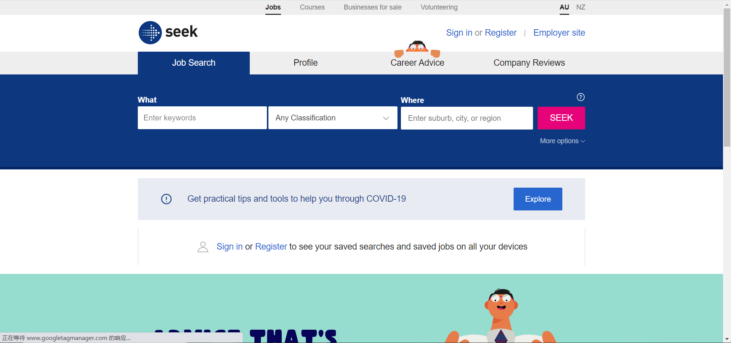
Identify particular sources
Follow three similar websites: Hipages, Airtasker and Seek
Hipages and Airtasker, these two pages are our main reference objects
Also refer to Seek's search function and simple UI design style
Hipages
Airtasker
Seek
https://hipages.com.au/
https://www.airtasker.com/sg/
https://www.seek.com.au/

Slide 8



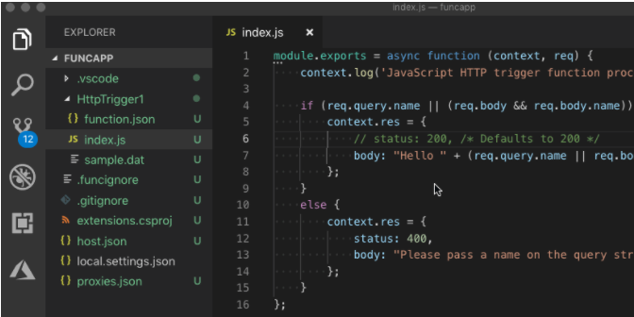
Tools selected & why
Front-end development:
Framework:
UI Library:
Code-compiler:
VUE
Element-UI
Visual Studio Code

Slide 9


Tools selected & why
Back-end development:
Framework:
Sharing Platform:
Code-compiler:
Django - python
GitHub
Visual Studio Code

Slide 10
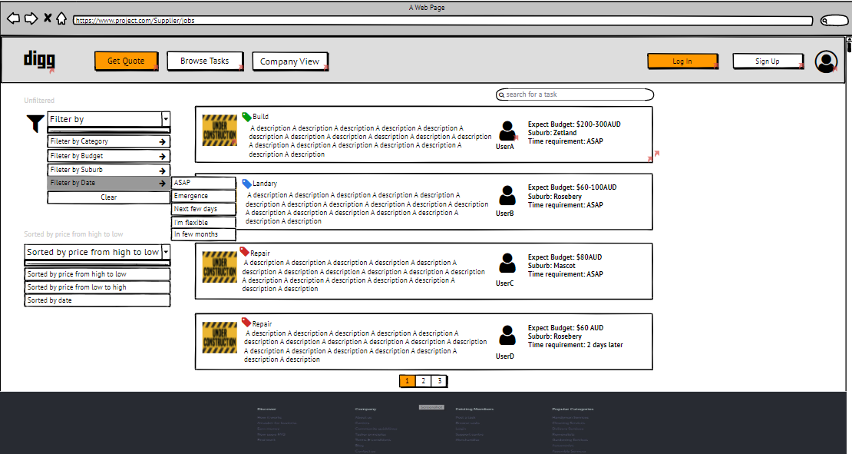
Current questions/problems
Development:
UI design – too simple
Database construction – no experience
The most difficult page “Browse Tasks” – search and filter function
Others:
Project Proposal – Not sure when to sign
Effectiveness: work separately < work together
Everyone’s code style is not uniform to cause conflict in coding

Slide 11
Thanks for listening!

